Slide 1
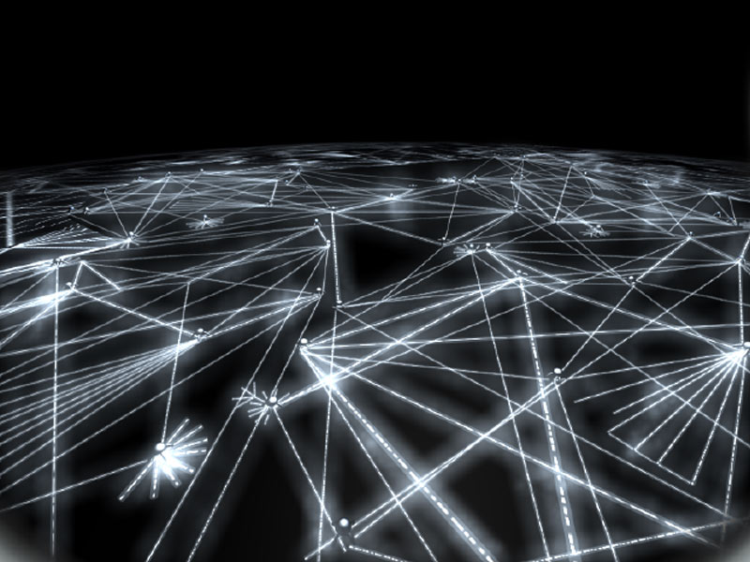
EE 230: Optical Fiber Communication
Lecture 8
Fiber Amplifiers
From the movie
Warriors of the Net

Slide 2
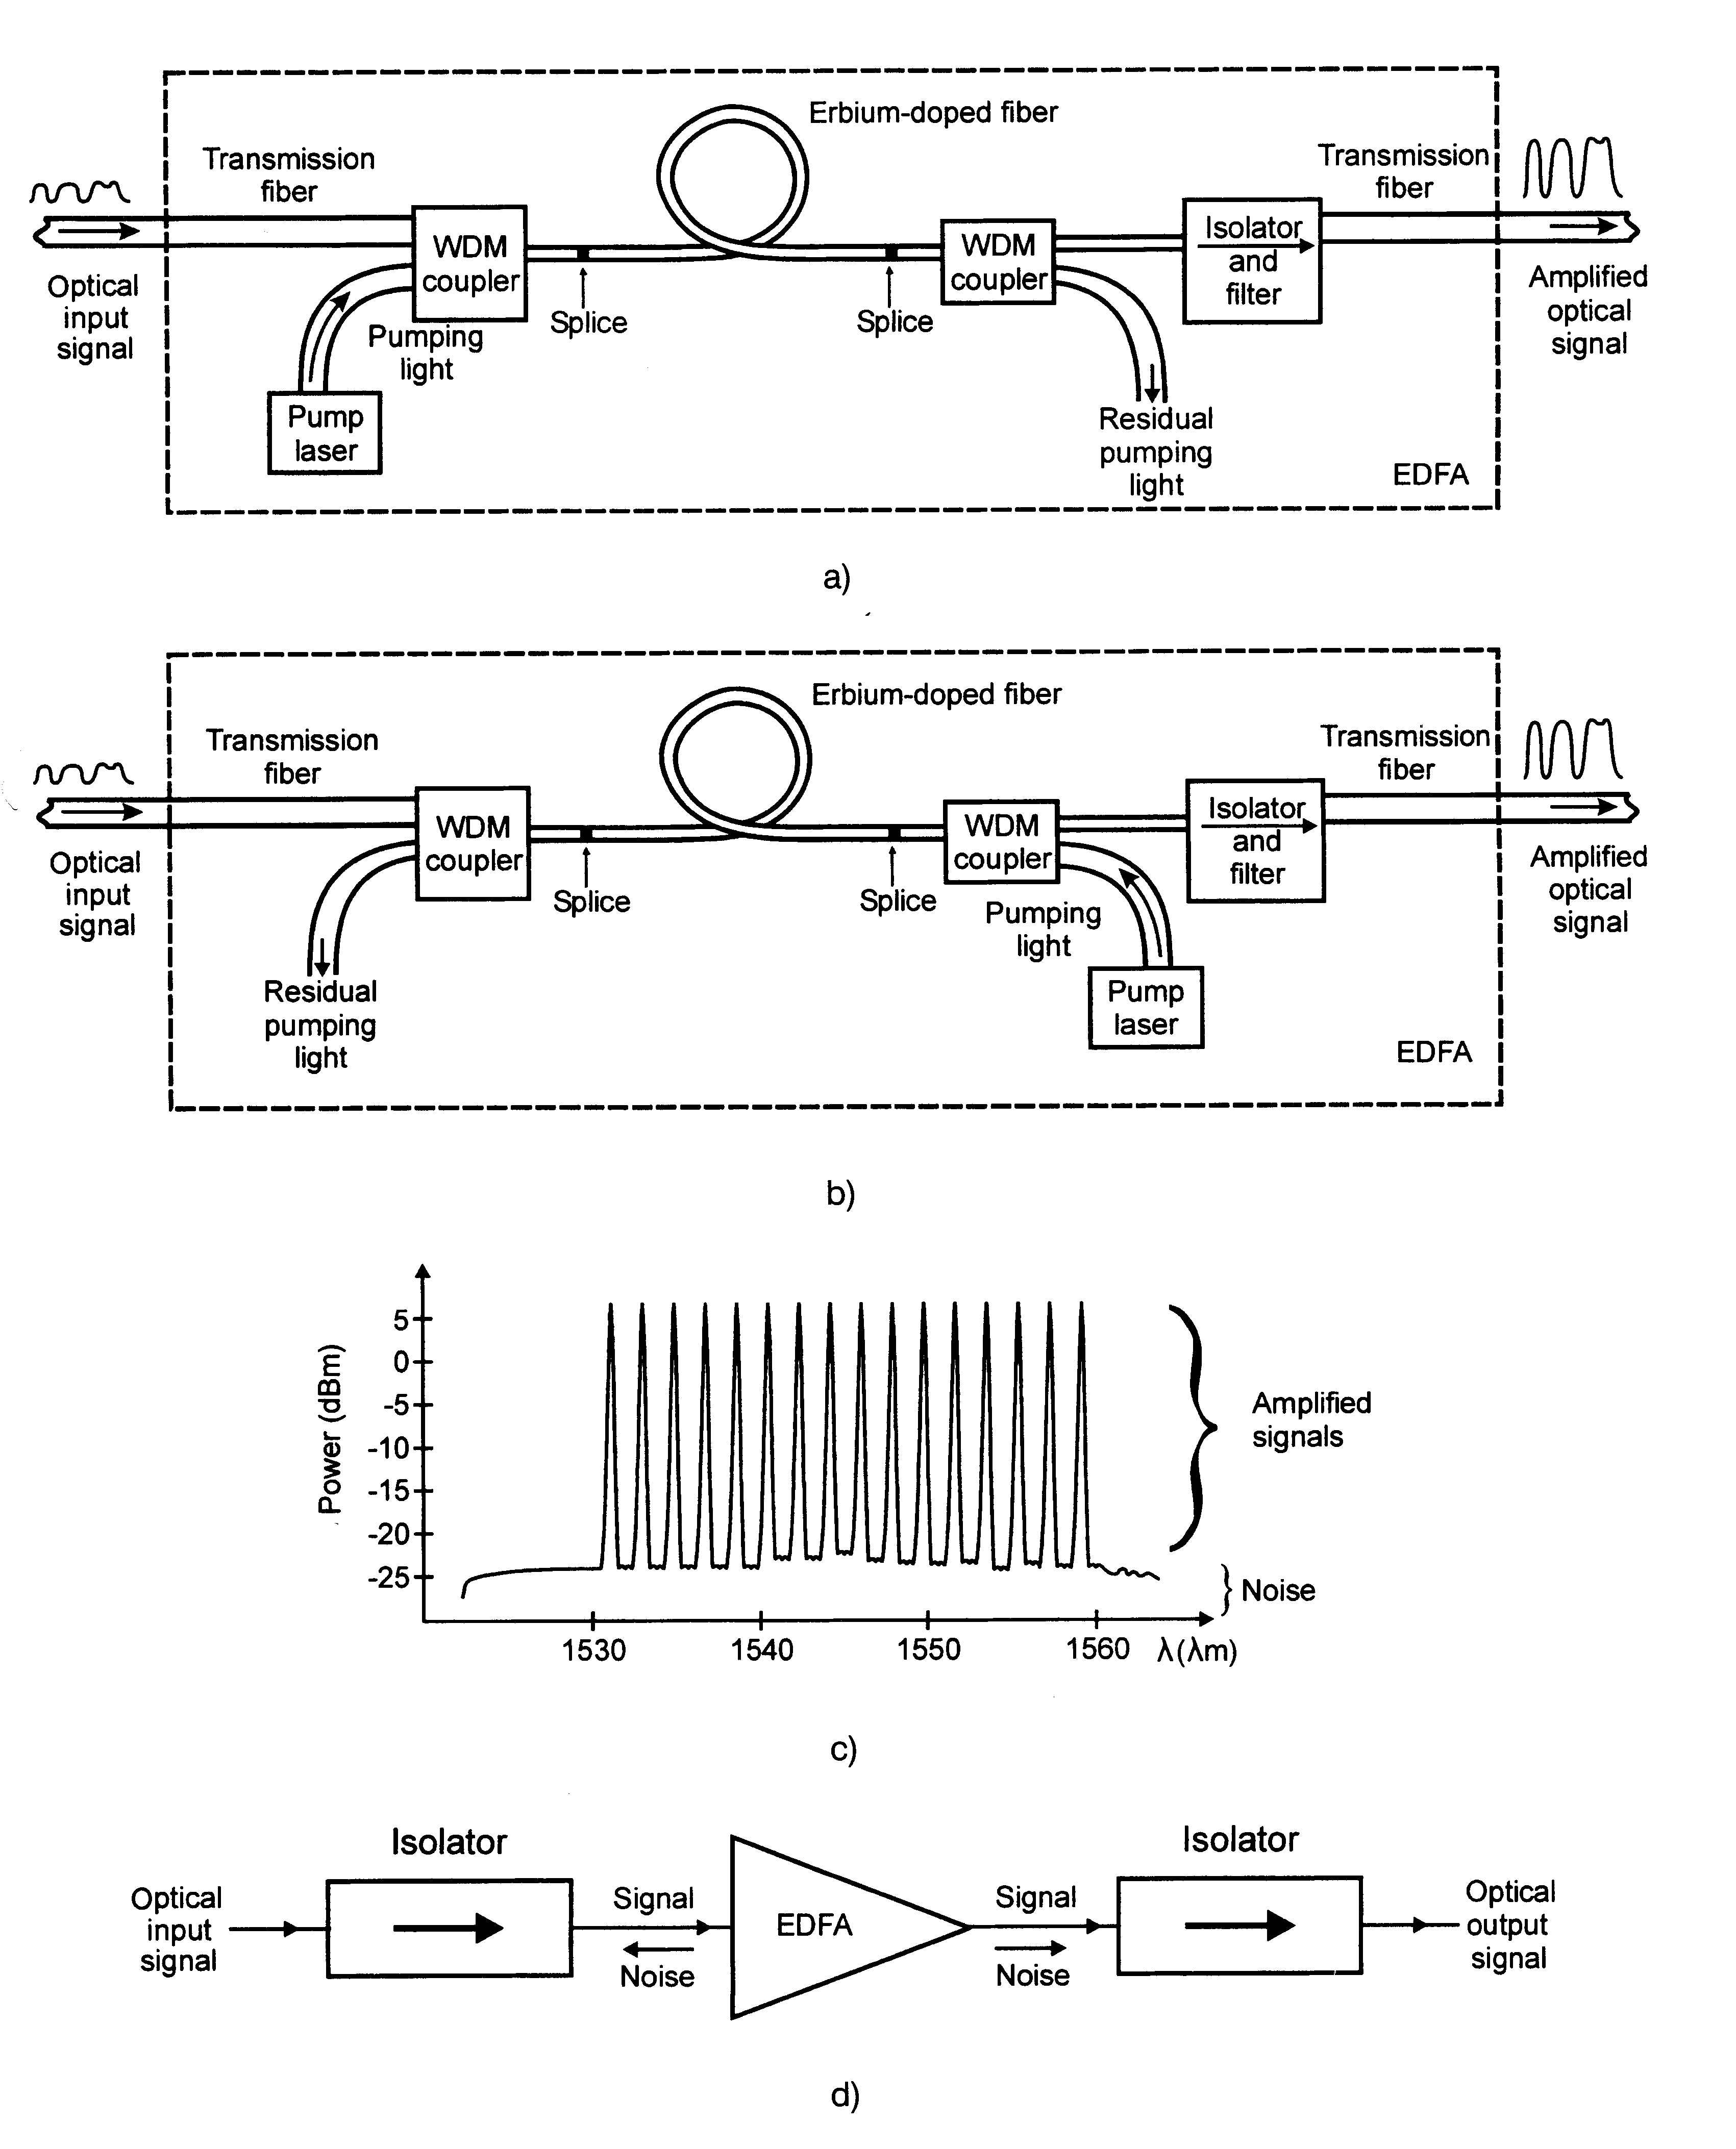
Erbium Doped Fiber Amplifier
EDFAs have revolutionized optical communications
All optical and fiber compatible
Wide bandwidth-20-70 nm
High Gain, 20-40 dB
High Power output >200 mW
Bit rate, modulation format, power and
wavelength insensitive
Low distortion and low noise (NF<5dB)
Low coupling loss
Fiber Optics Communication Technology-Mynbaev & Scheiner

Slide 3
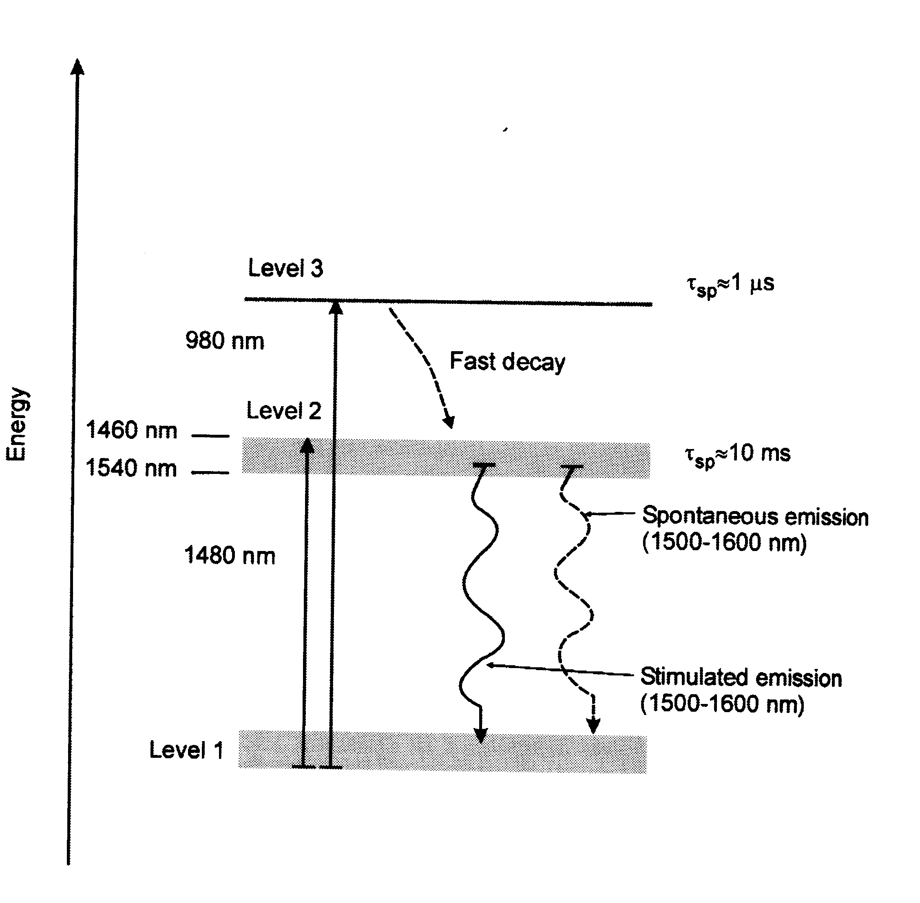
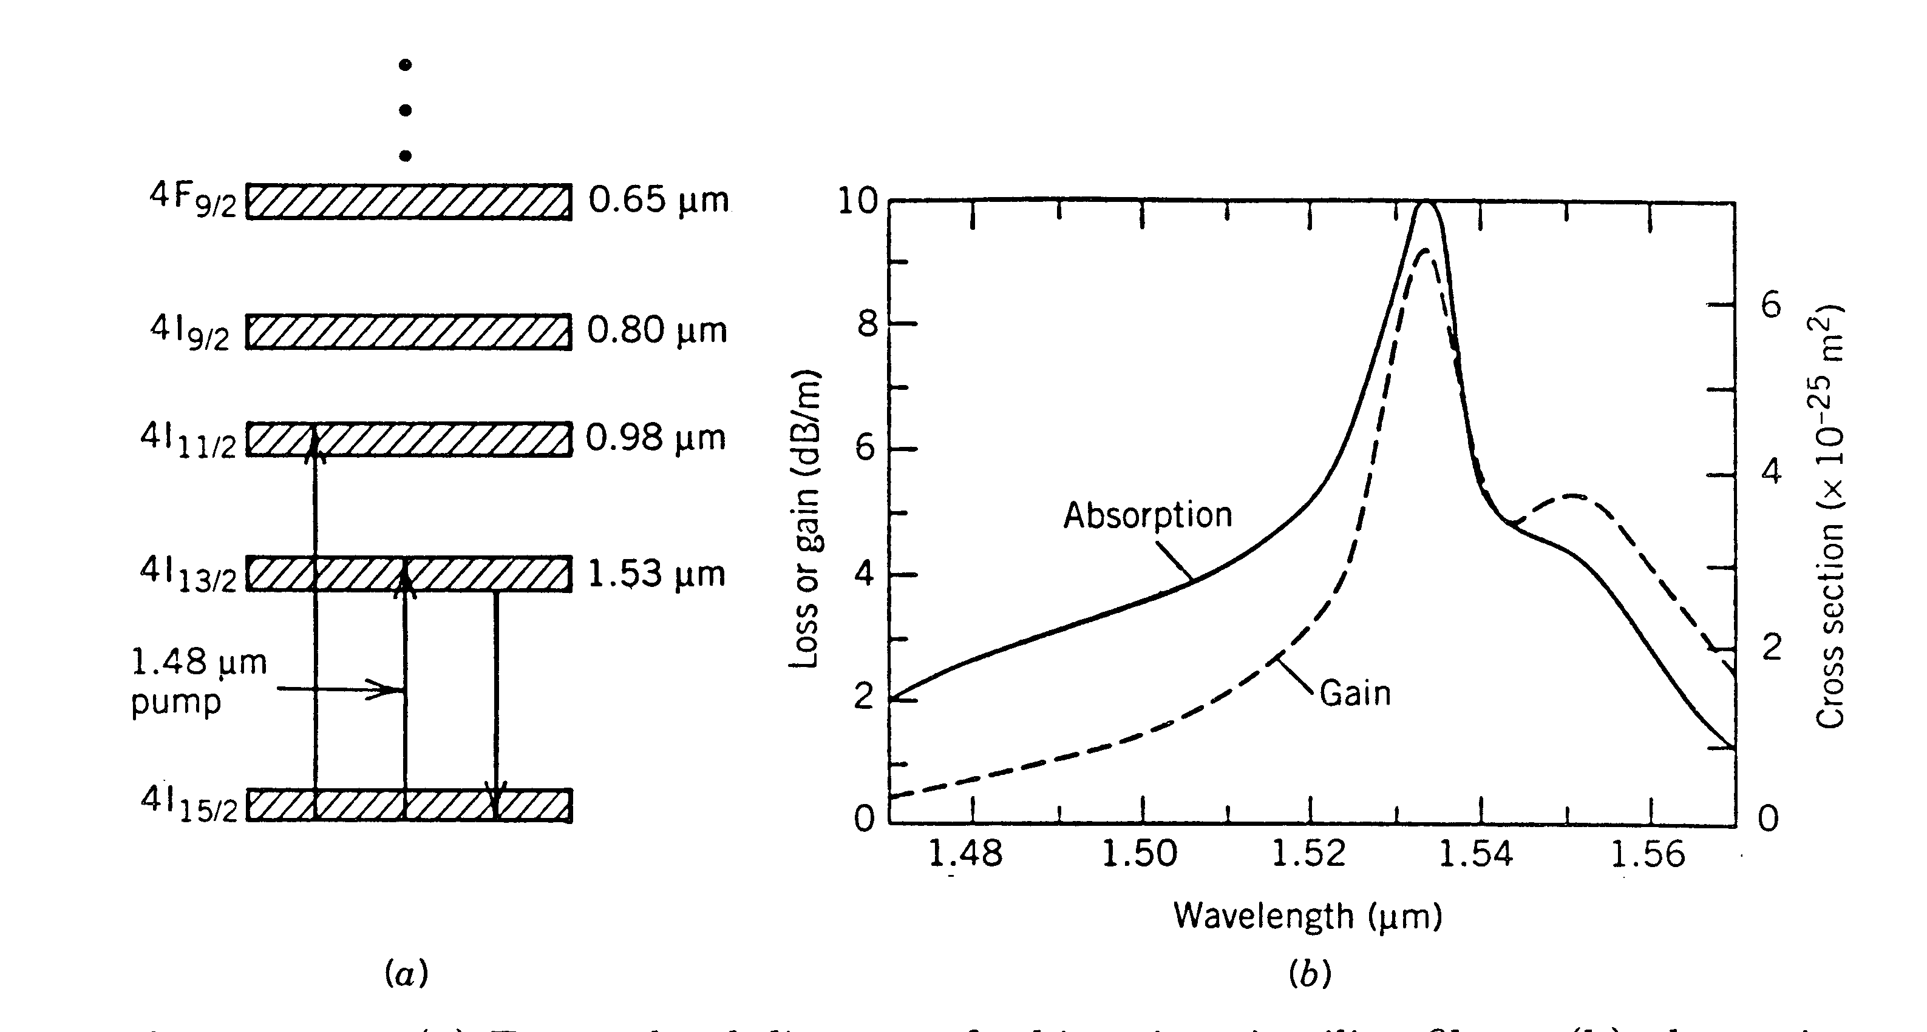
Erbium Atom Energy Levels
Energy Bands of Erbium ions in silica fibers along with decay rates and pumping possibilities
Energy level diagram of erbium ions in silica fibers along with the absorbtion and gain spectra of an EDFA whose core was codoped with germania to increase the refractive index
Fiber Optics Communication Technology-Mynbaev & Scheiner

Slide 4
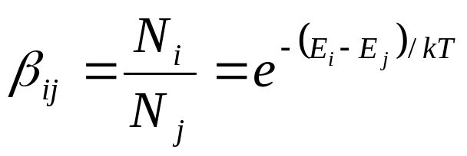
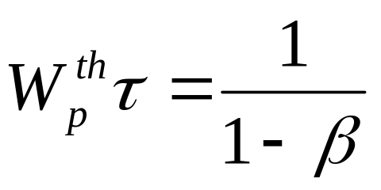
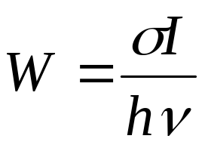
Lifetime and pump power
Boltzmann factor gives relative populations in energy levels
Transition probability W inversely proportional to excited state lifetime
At threshold, pump intensity in core gives W:

Slide 5
Lifetime example, continued
If Γ=0.4, cross section for pumping is 4.2x10⁻²² cm², core radius is 2 μm, pump wavelength is 1.48 μm, and Boltzmann factor is 0.38, what is the lifetime of the excited state?
Pump intensity is power divided by area
Lifetime is 8.1 ms

Slide 6
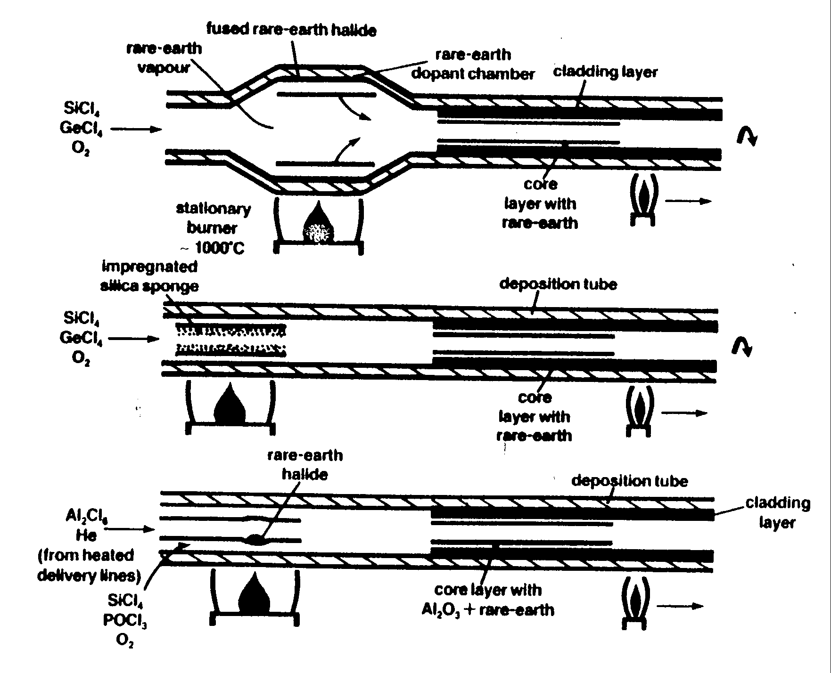
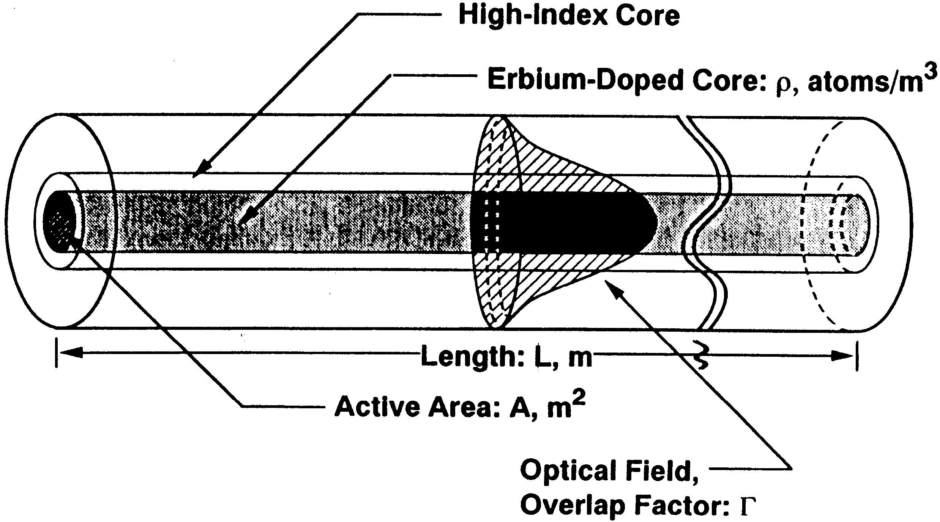
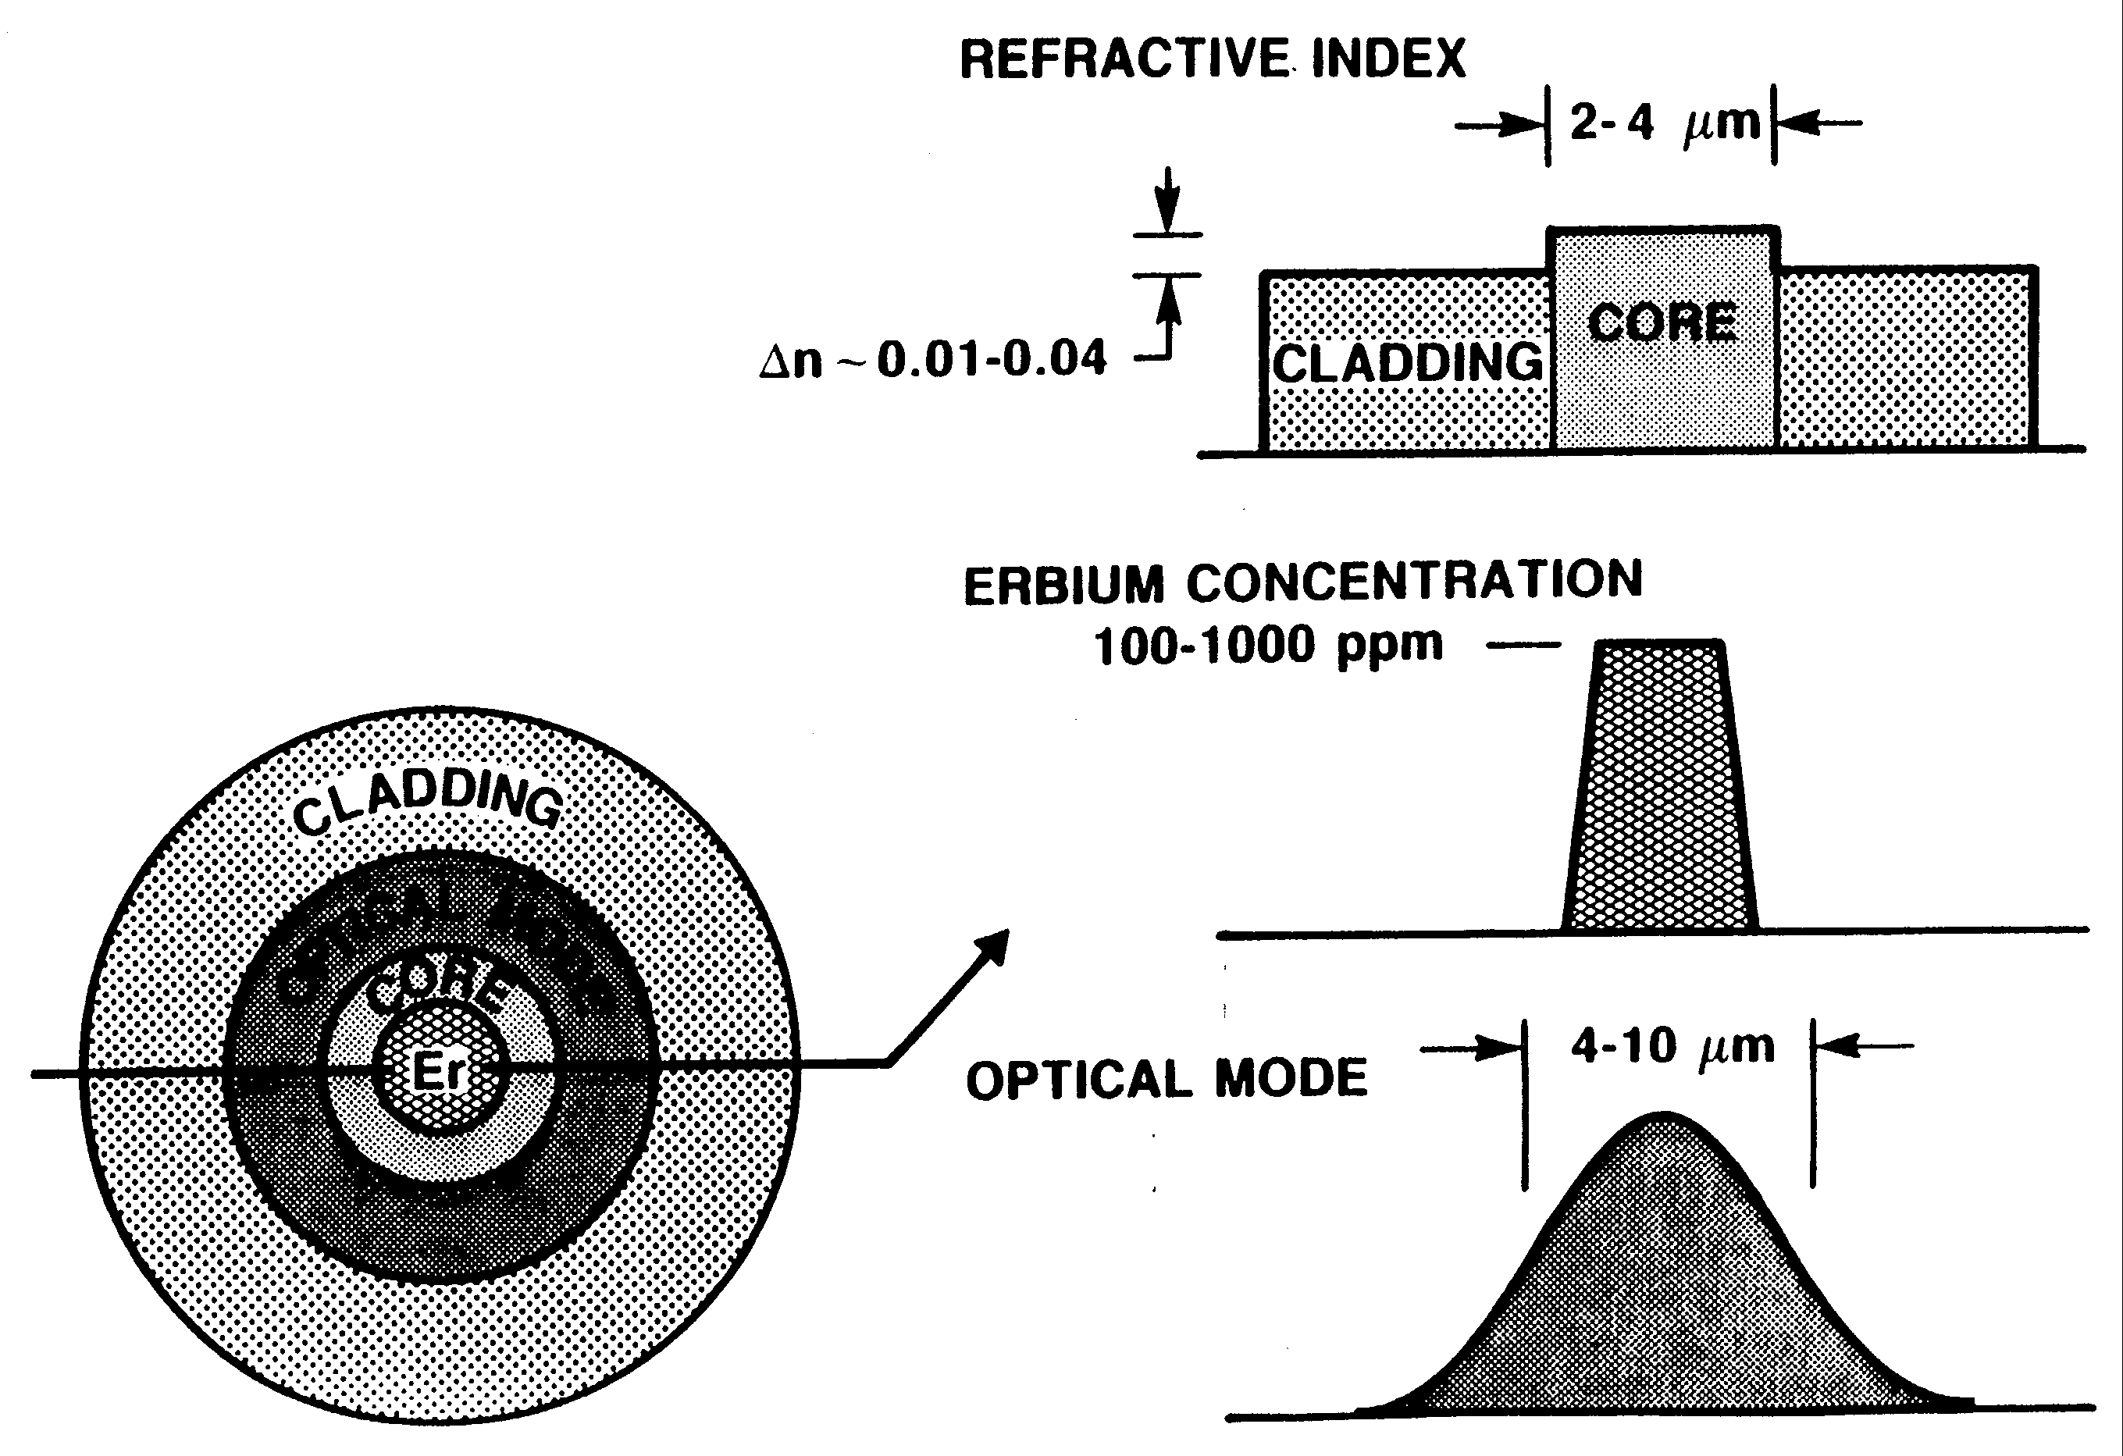
Erbium Doped Fiber

Slide 7
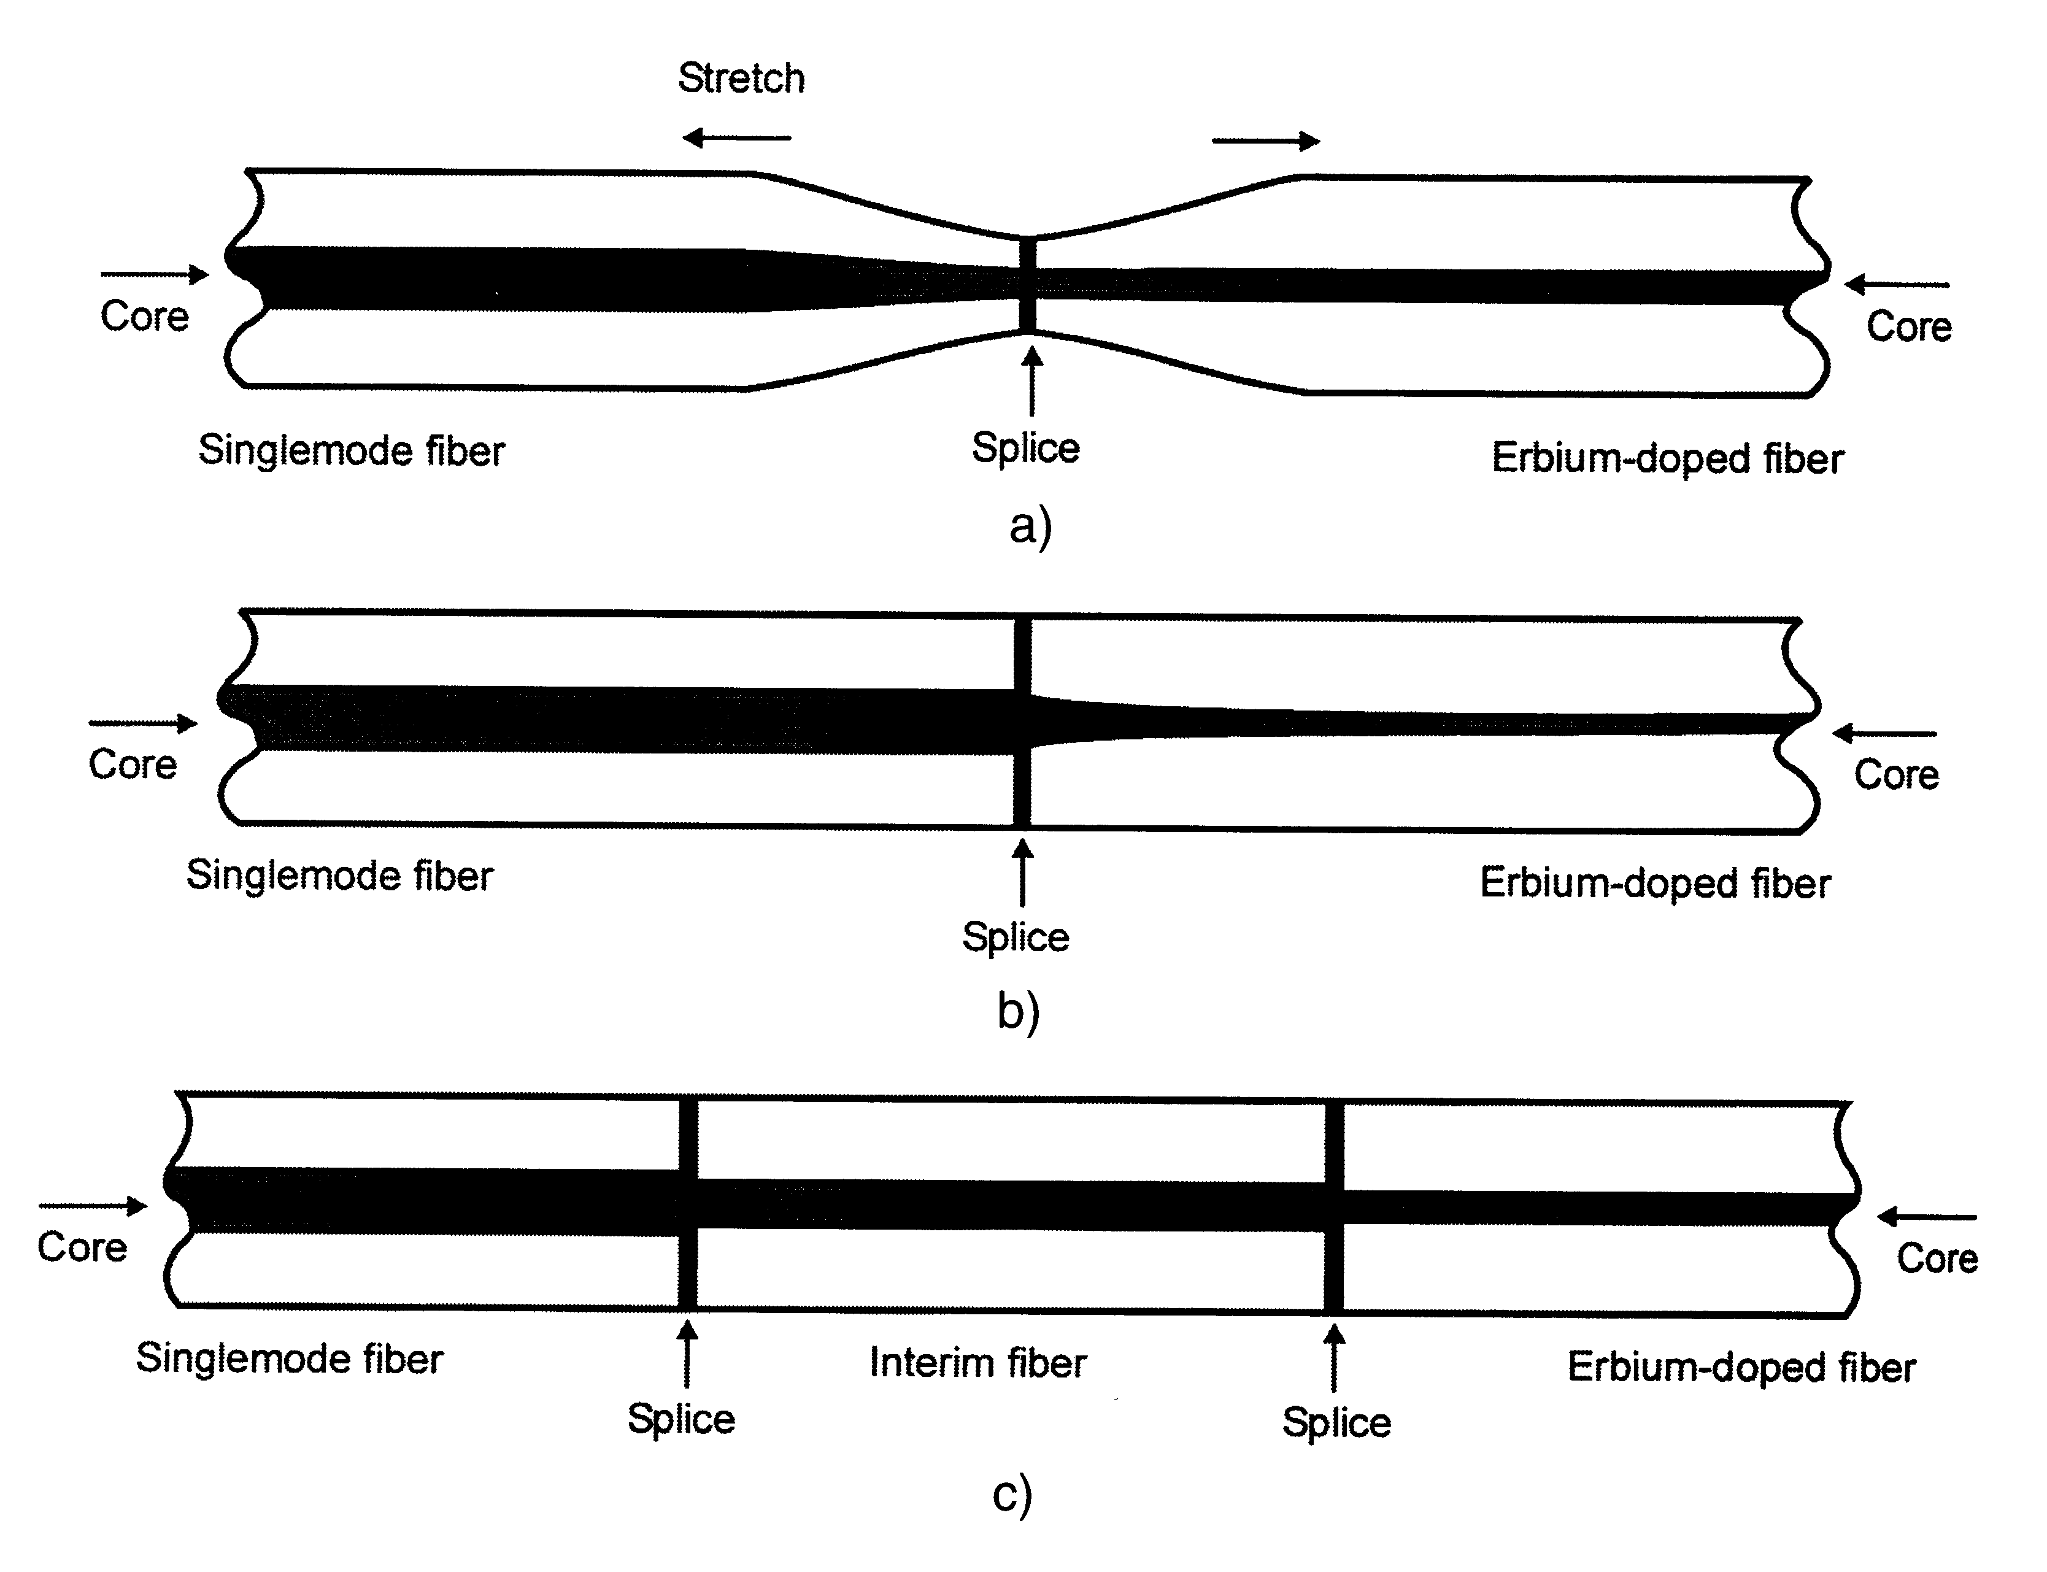
Splicing an erbium doped fiber
Down Tapering
Up Tapering
(TEC Method)
Interim Fiber
A straight butt splice to standard single-mode fiber wold have a loss of 2-3 dB
these methods reduce splice loss to 0.1-0.3 dB

Slide 8
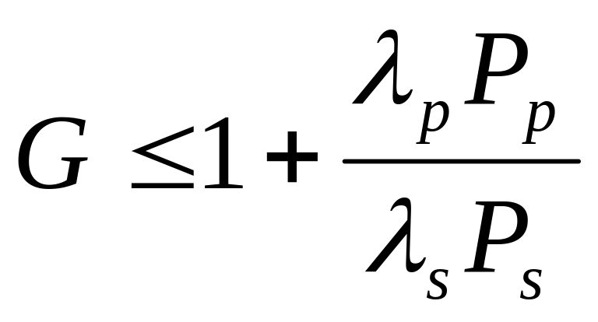
Maximum possible gain

Slide 9
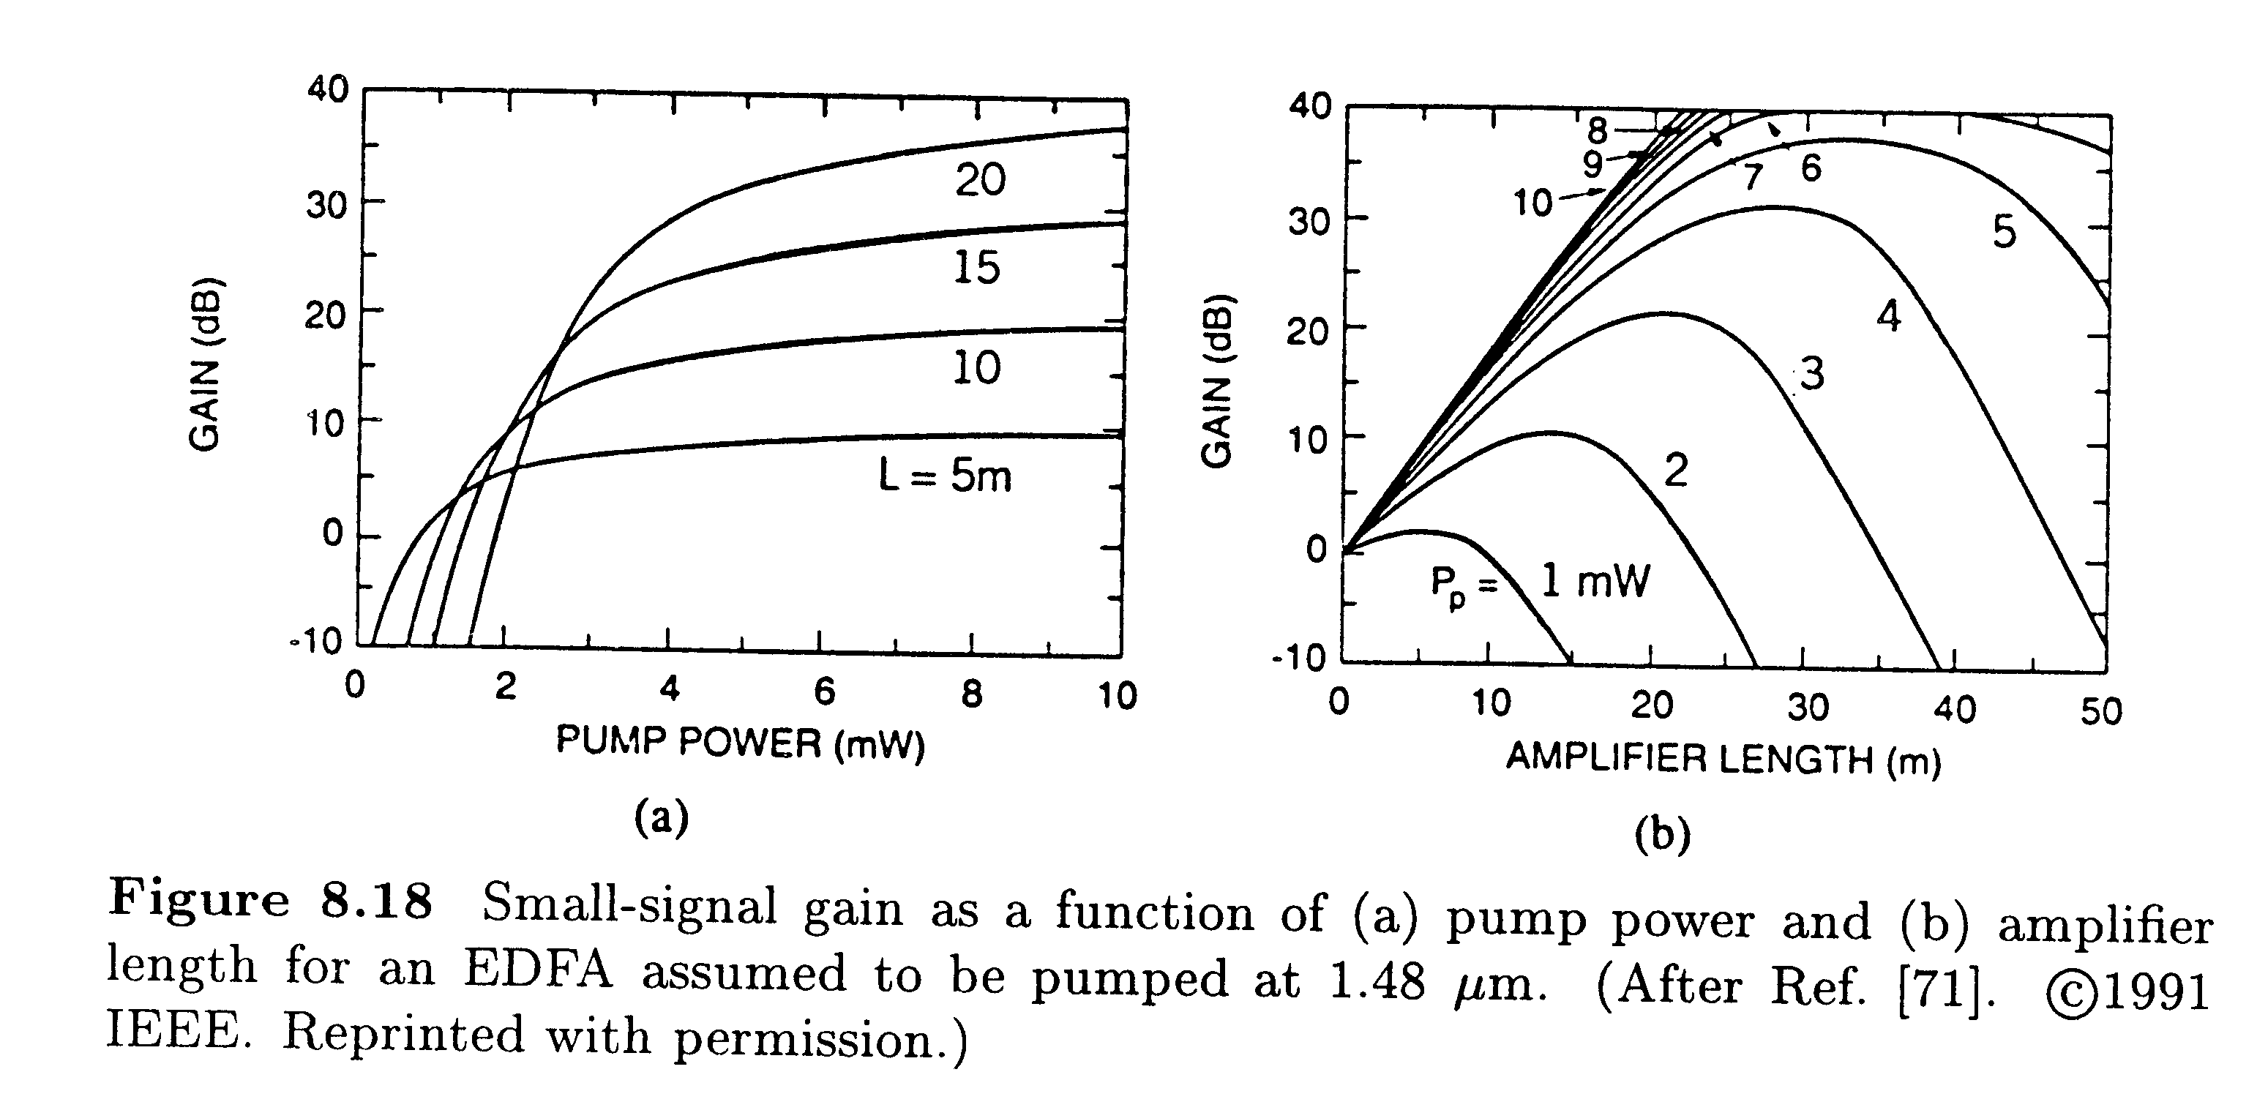
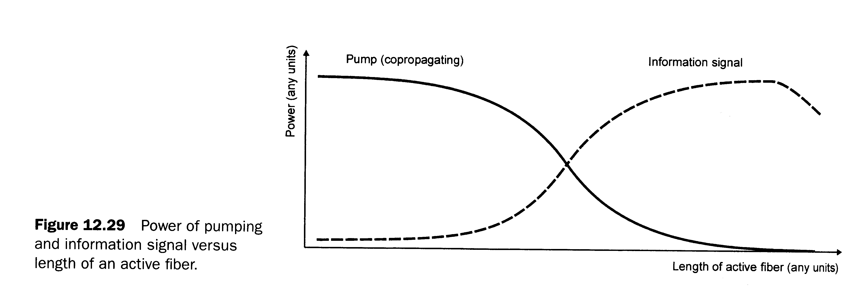
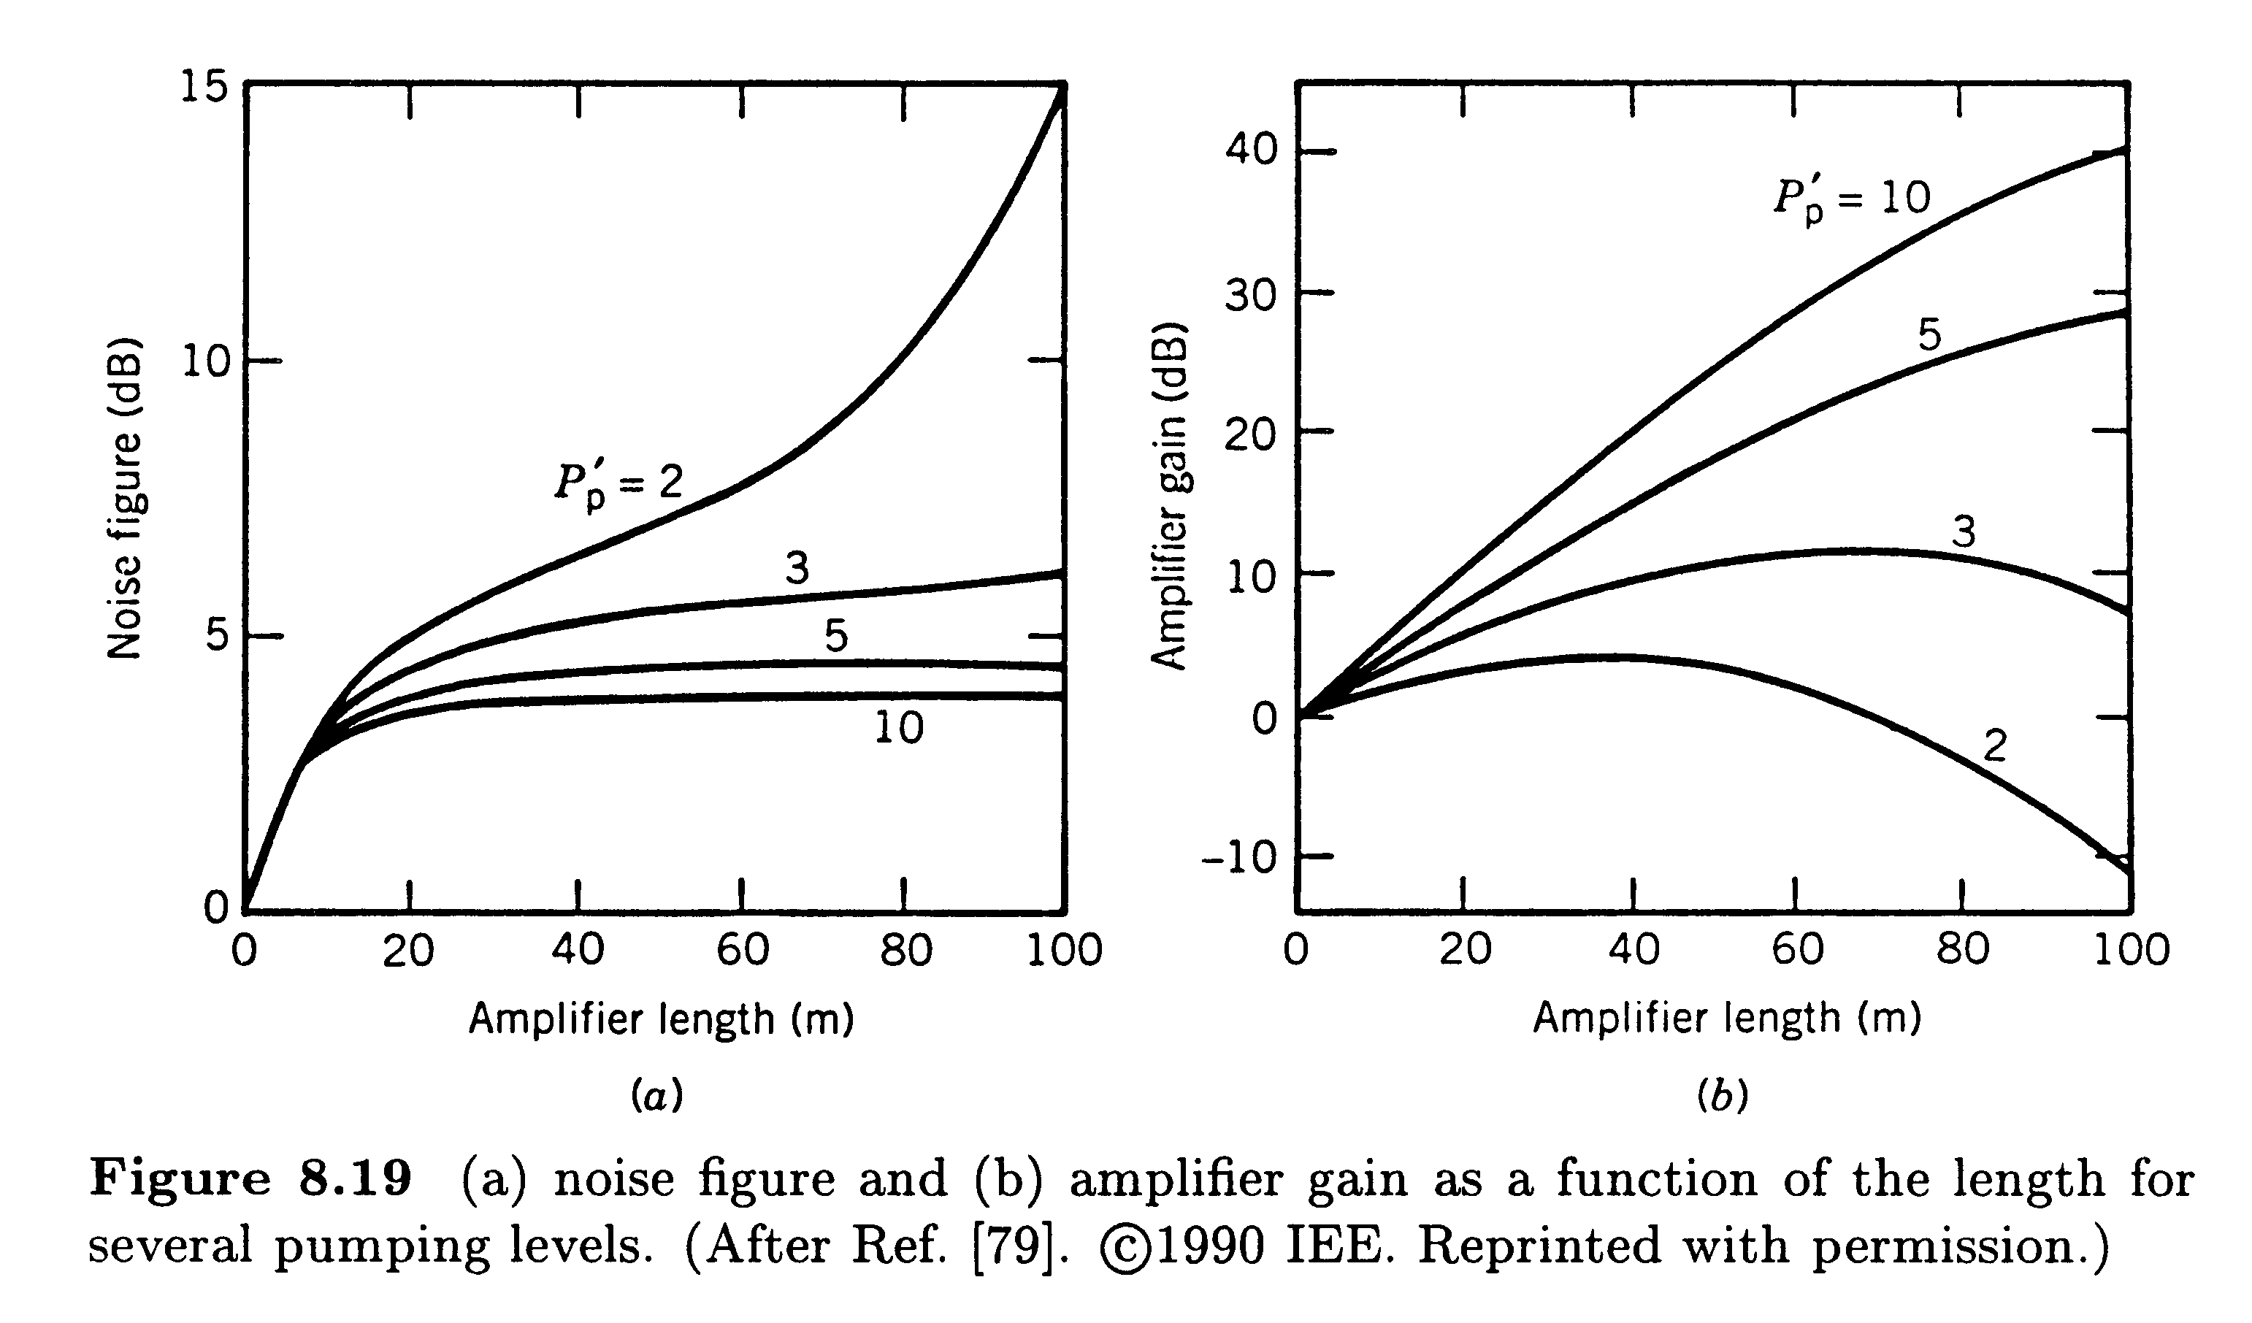
Saturation Characteristics
Fiber Optic Communication Systems - Agrawal
Fiber Optics Communication Technology-Mynbaev & Scheiner

Slide 10
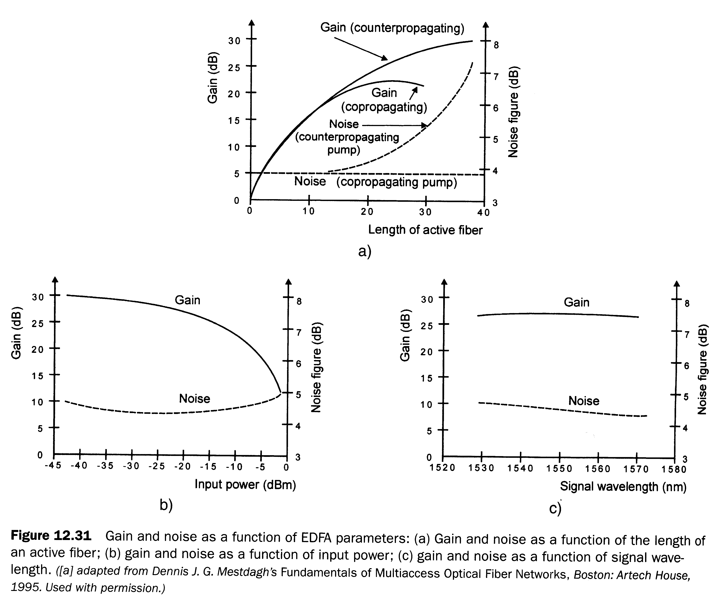
Gain and Noise in an EDFA

Slide 11
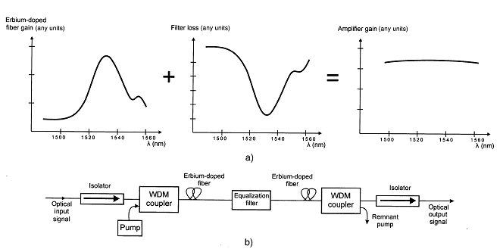
Gain Flattening for Multi-channel Systems

Slide 12
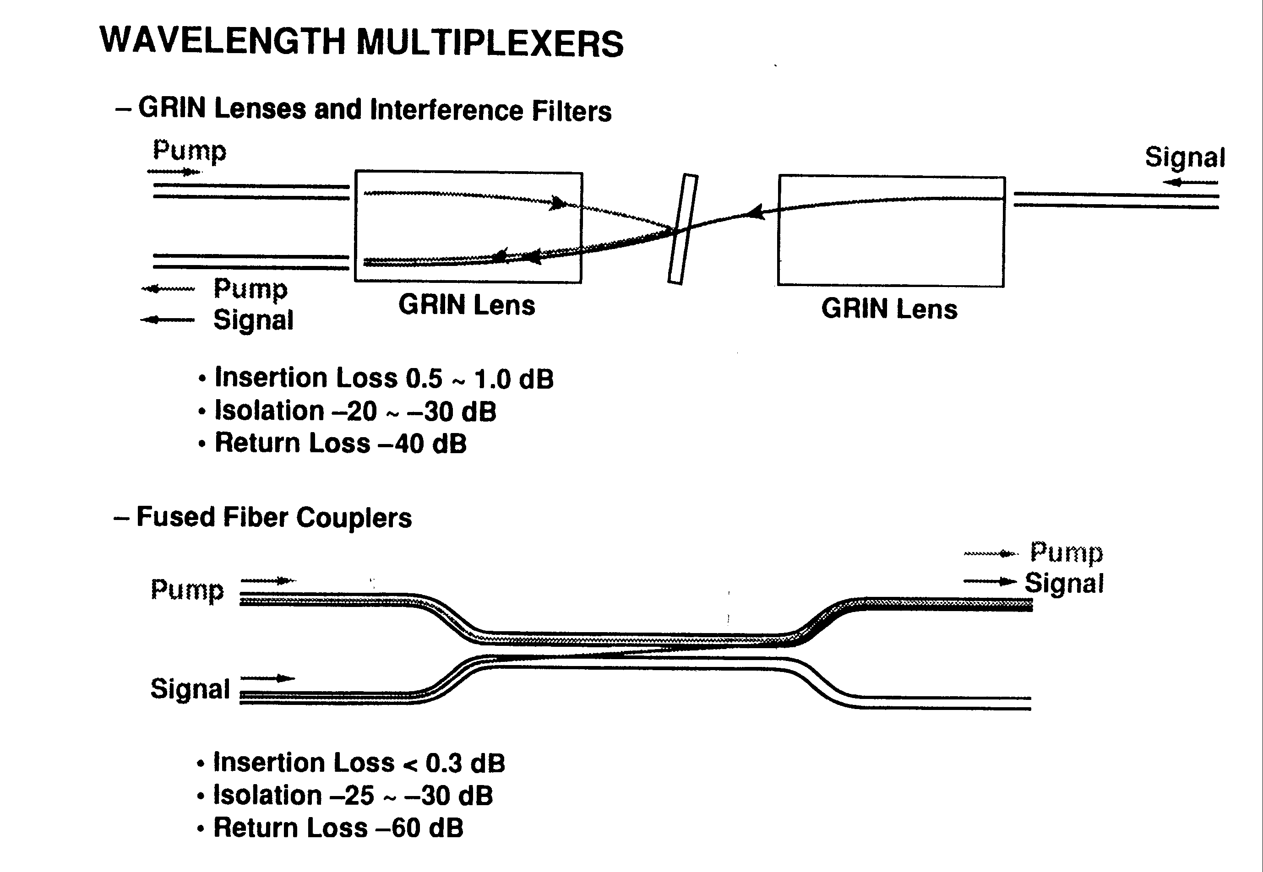
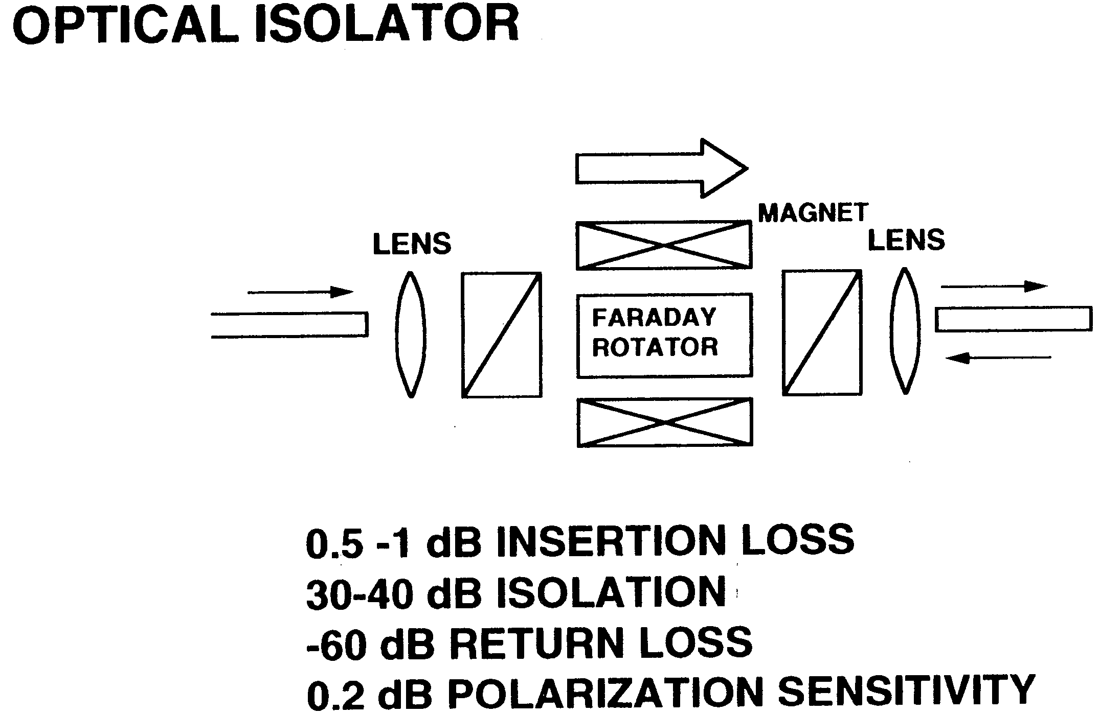
Passive Components for EDFAs

Slide 13
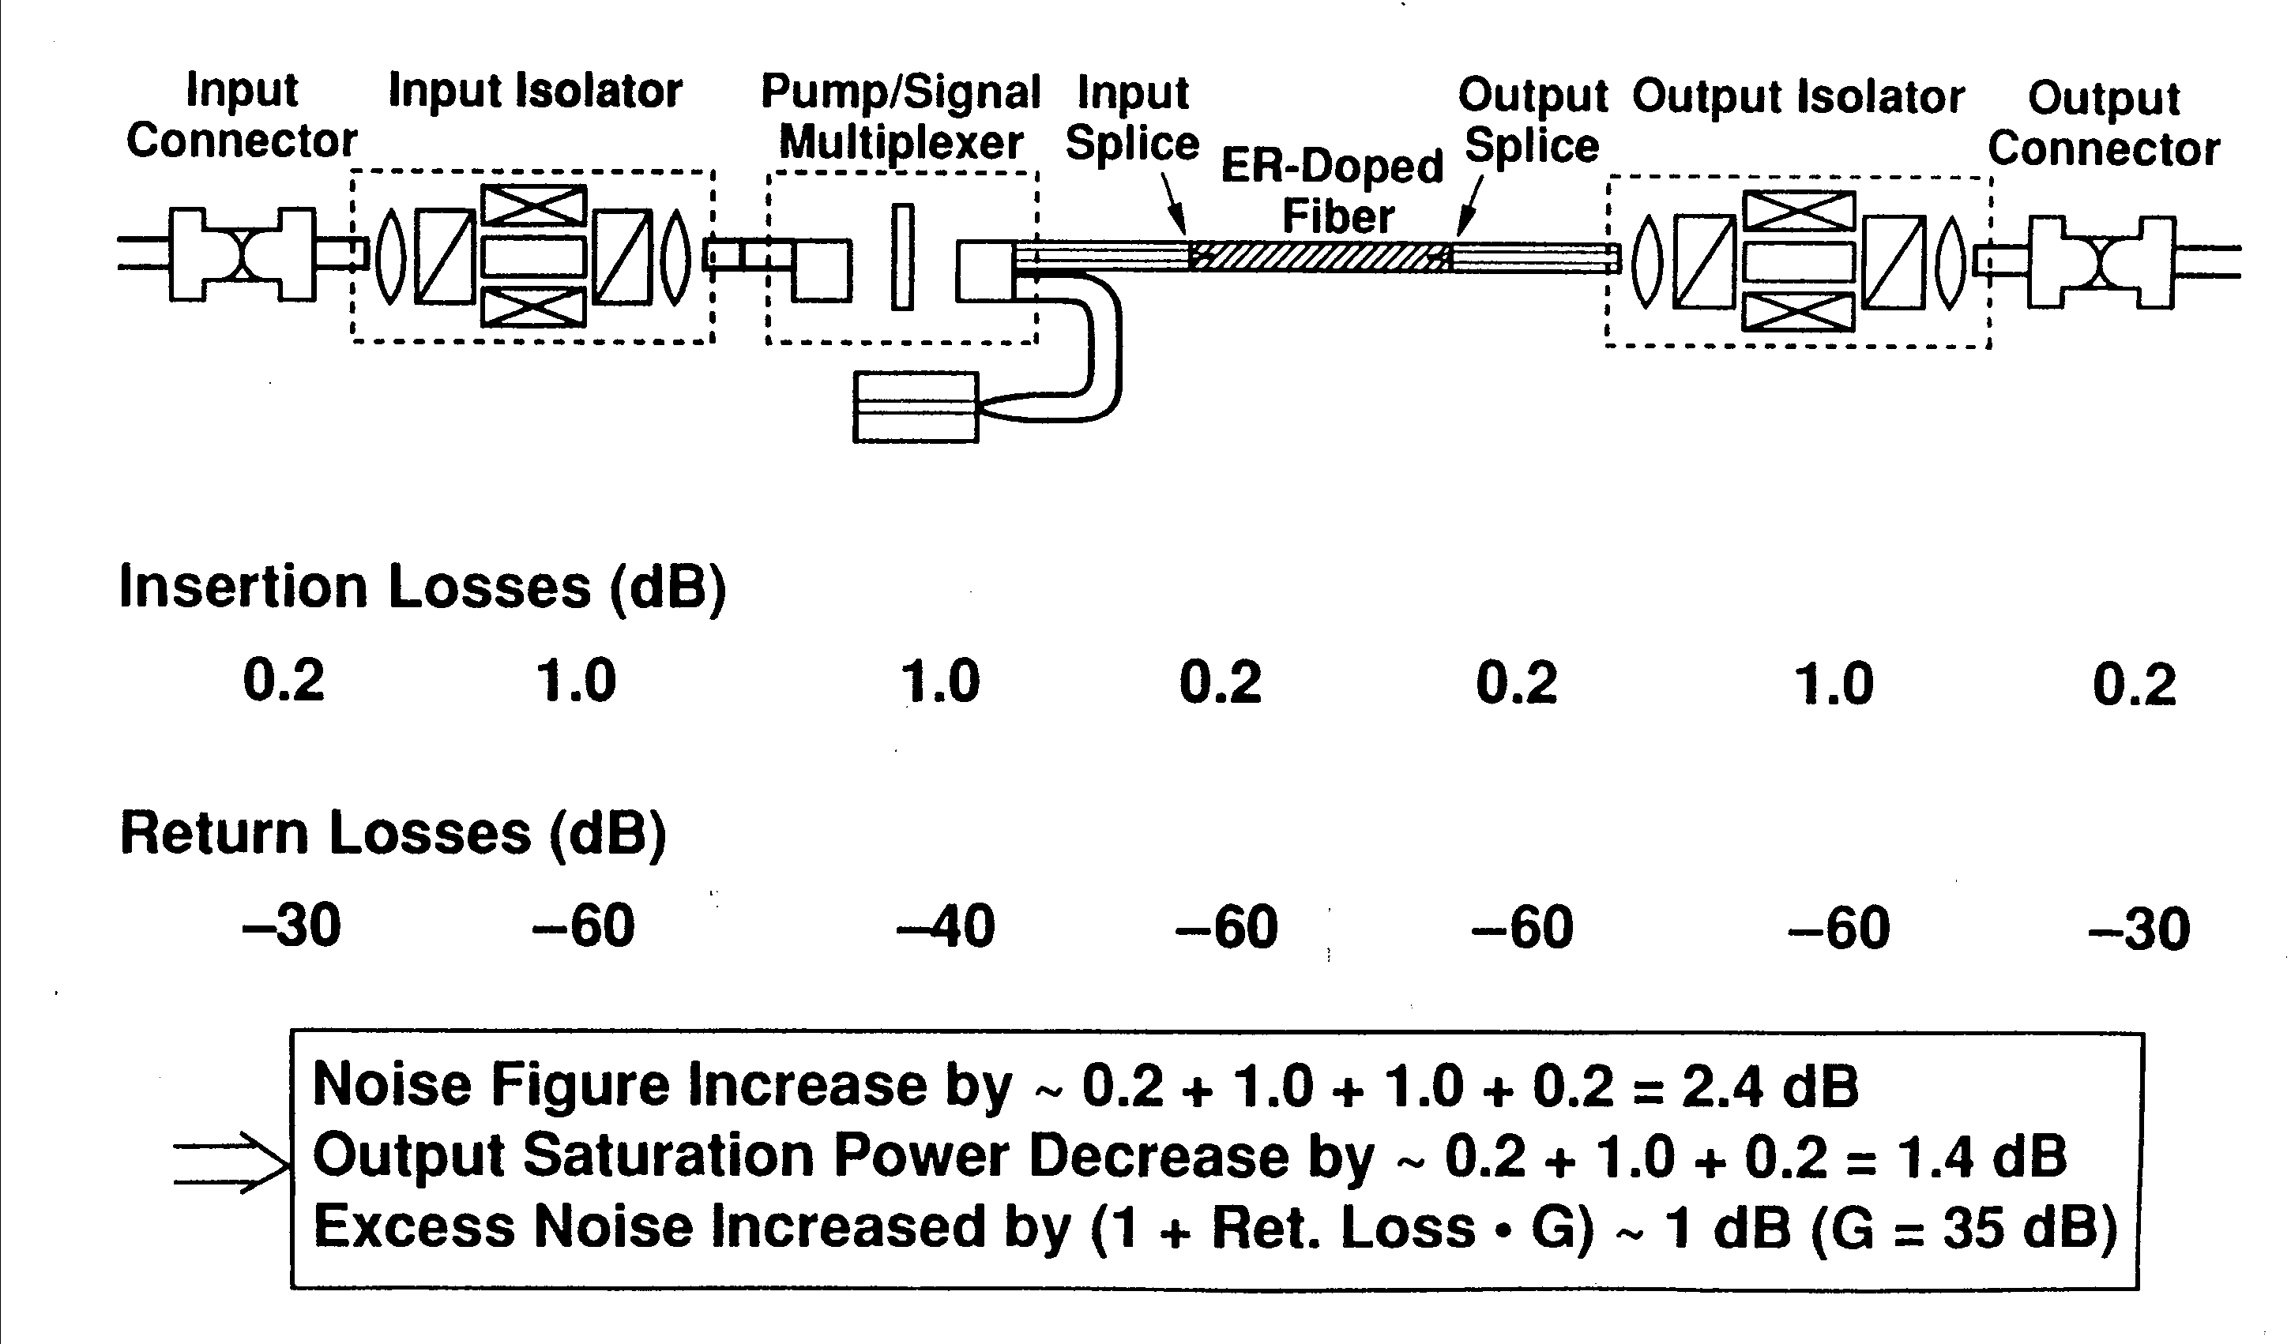
Typical EDFA

Slide 14
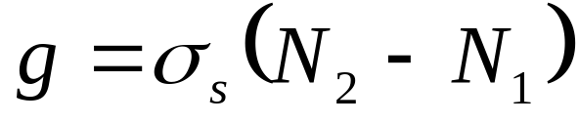
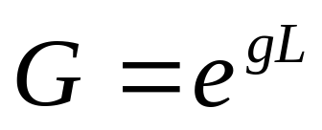
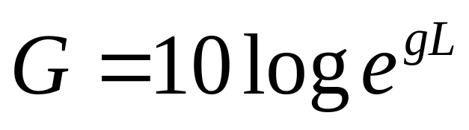
Required length of Er-doped fiber
Gain coefficient per length g depends on population inversion and cross section for stimulated emission
Overall gain depends on g and length L
Expressed in decibels:

Slide 15
Example of doped fiber length
N₁=1.8x10¹⁷ cm⁻³
N₂=4.8x10¹⁷ cm⁻³
σ_{s}=7.0x10⁻²¹ cm²
g=2.1x10⁻³ cm⁻¹
How long does the fiber need to be for G to be equal to 35 dB?
L=38.4 meters!

Slide 16
How to mitigate long doped fiber length
Use a material that can hold many more erbium ions—namely, a polymer.
If gain regions can be reduced to centimeters from tens of meters, polymer loss becomes insignificant
Short amplifiers might be integratable

Slide 17
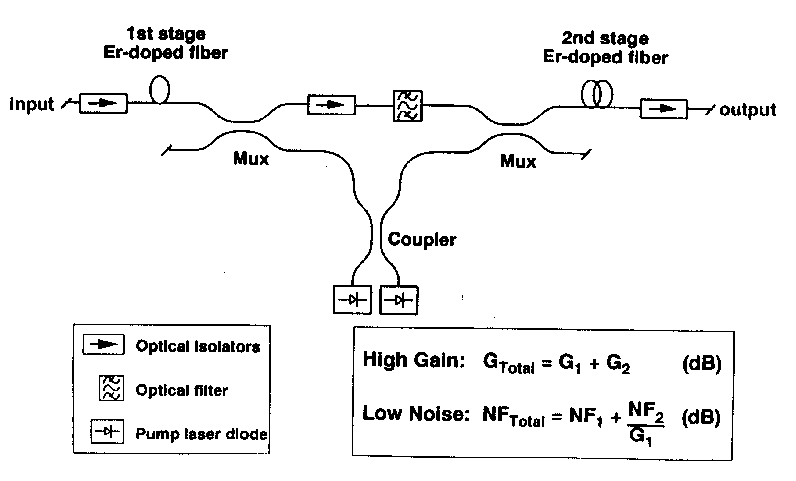
Two Stage Amplifier Design

Slide 18
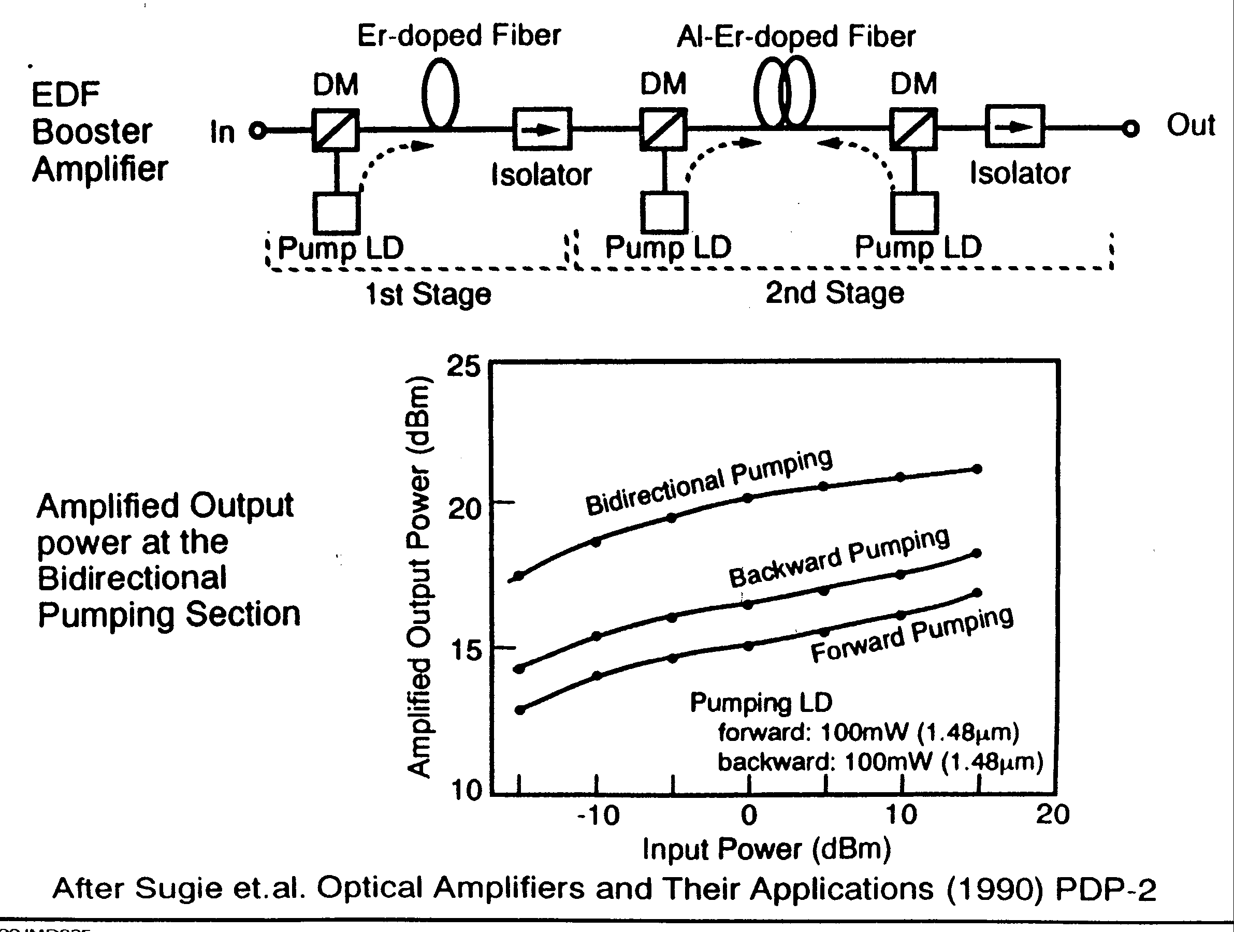
High power Booster Amplifier

Slide 19
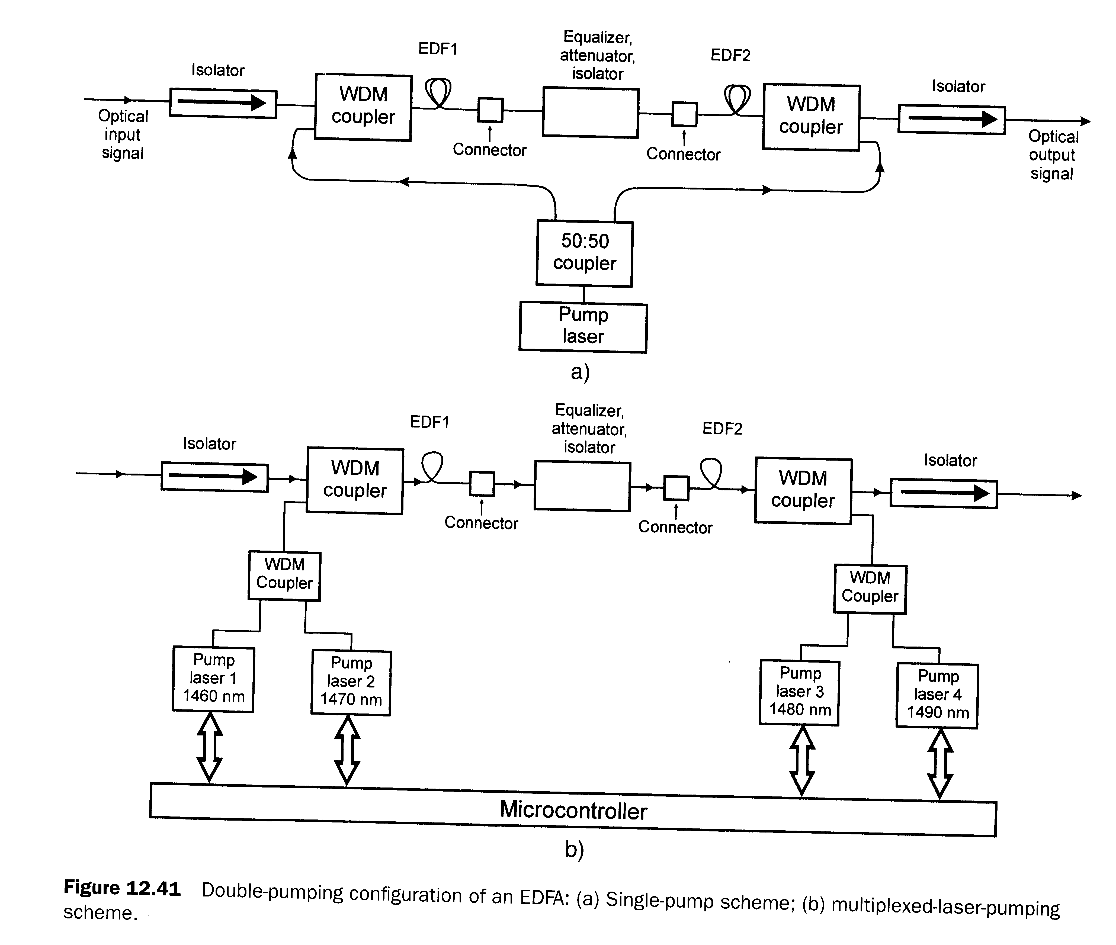
Alternate Pumping Schemes

Slide 20
Pumping Choices for EDFAs
Forward pumping generates less noise
Backward pumping generates higher gain
980 nm pumping generates both higher gain and less noise
1480 nm pumping generates higher saturated power and tolerates a broader range of pump wavelengths

Slide 21
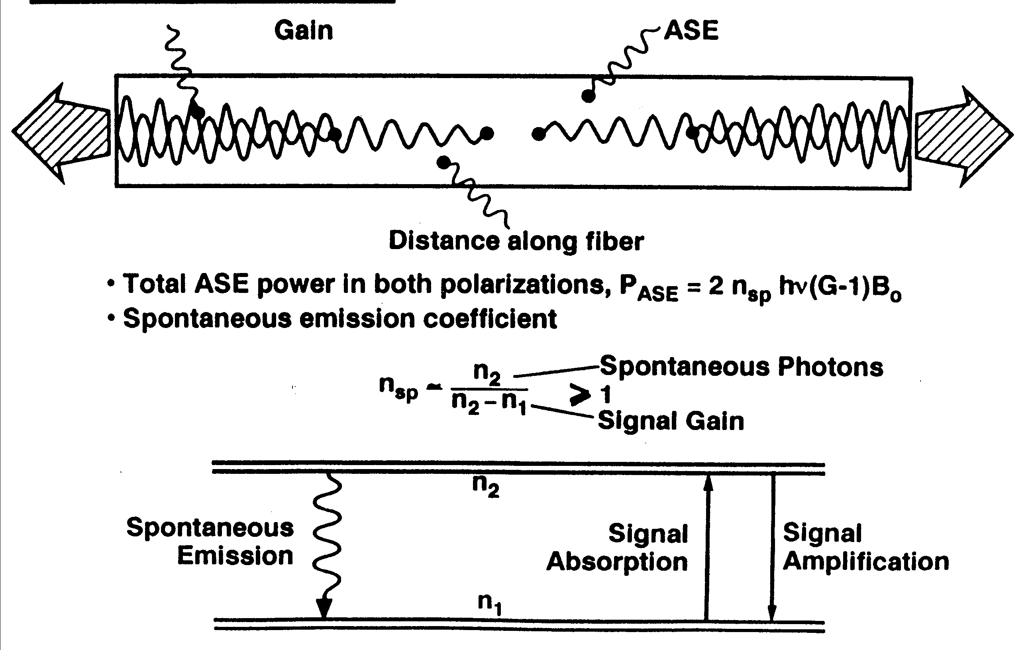
ASE power and Spontaneous Emission Coefficient

Slide 22
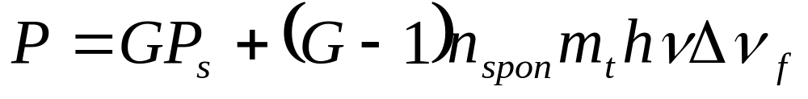
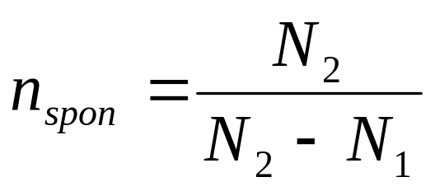
Power and noise outputs
Power out
where m_{t}=number of transverse modes, Δν_{f}=optical filter bandwidth, and n_{spon}=population inversion factor
First term is amplified power; second is Amplified Spontaneous Emission (ASE) noise

Slide 23
Example, continued
n_{spon}=1.6
G=35 dB=multiplication by 3162
ASE noise=65 μW

Slide 24
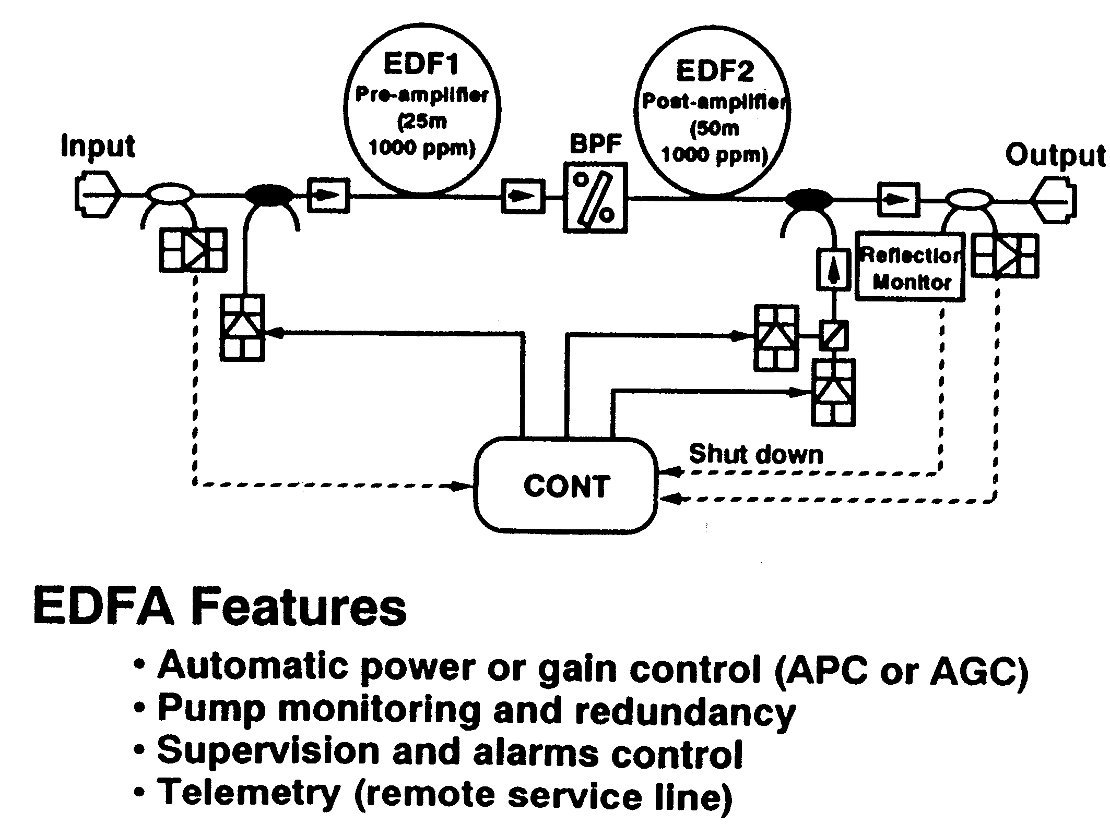
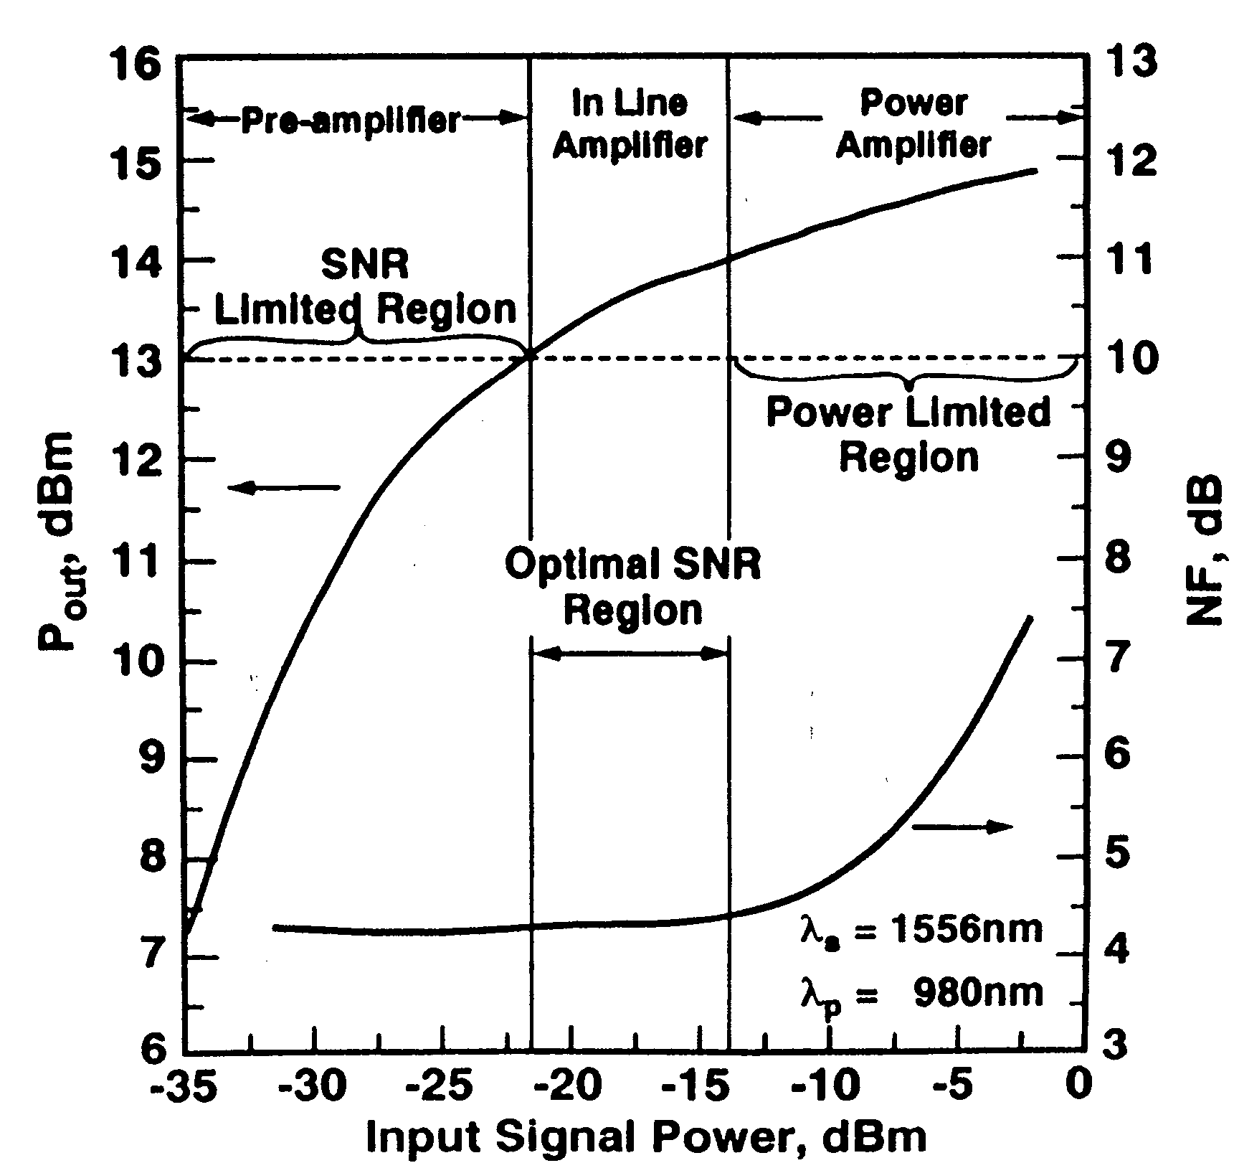
EDFA for Repeater Applications

Slide 25
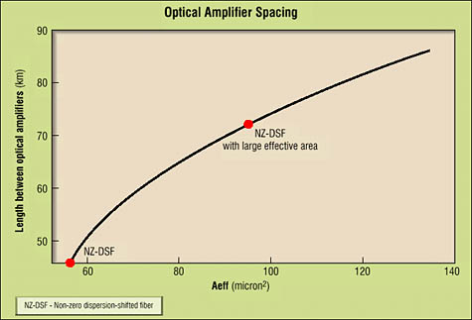
Optical Amplifier Spacing

Slide 26
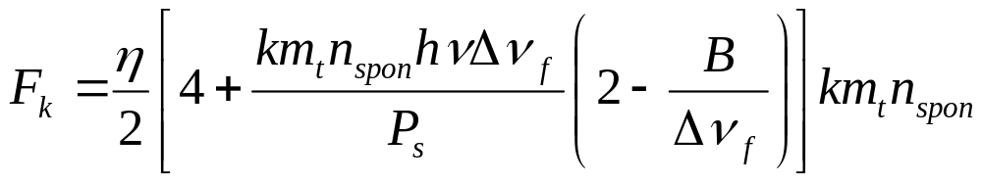
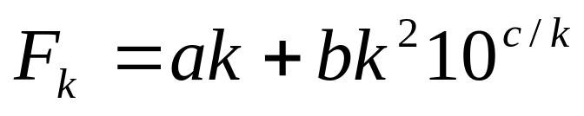
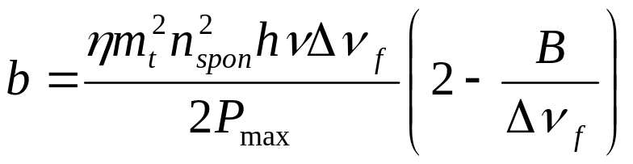
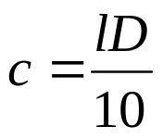
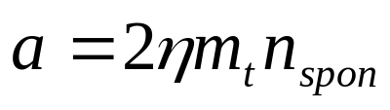
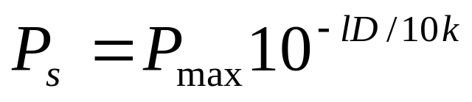
Optimum number of amplifiers
Noise figure for a chain of k amplifiers (ratio of S/N in to that of output)
Can be rewritten as
where
since

Slide 27
Example
PIN diode responsitivity η=1
Number of transverse modes m_{t}=1
Population inversion factor n_{spon}=2
λ=1.55 μm
P_{max}=10 mW
Loss coefficient l=0.2 dB/km
Preamp bandwidth B=optical filter bandwidth Δν_{f}=100 GHz
Distance D=1000 km

Slide 28
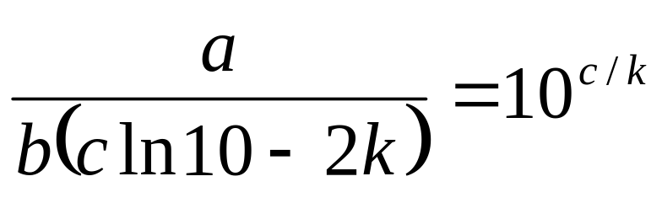
Example continued
We want dF/dk to be zero. Have to do it by trial and error.
What value of k makes this the smallest?
a=4 c=20
b=2.57x10⁻⁶

Slide 29
Answers
Derivative closest to zero when k=5
Gain of each amplifier is thus lD/k=40 dB
Noise figure at k=5 is 20.64. At k=4 or k=6 it is higher.

Slide 30
Erbium amplifier advantages
High gain per mW of pump power
Low crosstalk
Happen to operate in most transparent region of the spectrum for glass fiber
Extremely long excited state lifetime (on the order of 10 ms)

Slide 31
Erbium amplifier disadvantages
Can only work at wavelengths where Er⁺³ fluoresces
Requires specially doped fiber as gain medium
Three-level system, so gain medium is opaque at signal wavelengths until pumped
Requires long path length of gain medium (tens of meters in glass)
Gain very wavelength-dependent and must be flattened
Gain limited by cooperative quenching

Slide 32
Raman amplifiers
Use stimulated Raman effect and pump laser whose frequency is equal to signal frequency plus frequency of chemical bond in the material
Because it is a nonlinear process, requires very high pump powers (watts)

Slide 33
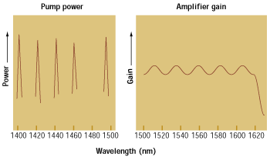
Multi-laser Raman Pumping

Slide 34
Raman amplifier advantages
Can use existing fiber as gain medium (distributed amplification)
Can operate in any region of the spectrum

Slide 35
Raman amplifier disadvantages
Require very high pump powers
Can be used only over long distances, since Raman effect is weak
Rayleigh scattering dominates, causing loss of pump power

